Slide 1
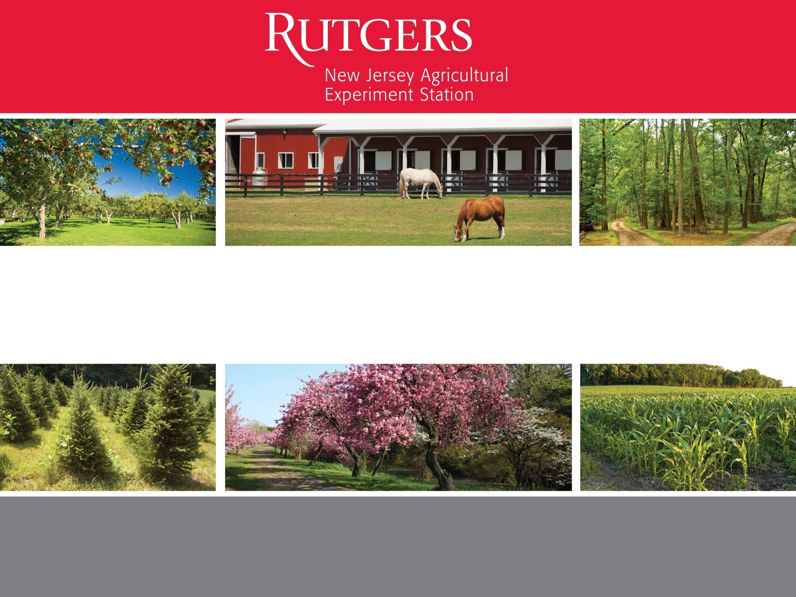
NJAES Research and Technical Assistance for
Climate Change and Agriculture
Peggy Brennan-Tonetta, Associate Director, NJAES
Brian Schilling, Director, Rutgers Cooperative Extension
Marjorie Kaplan, Associate Director, Rutgers Climate Institute

Slide 2
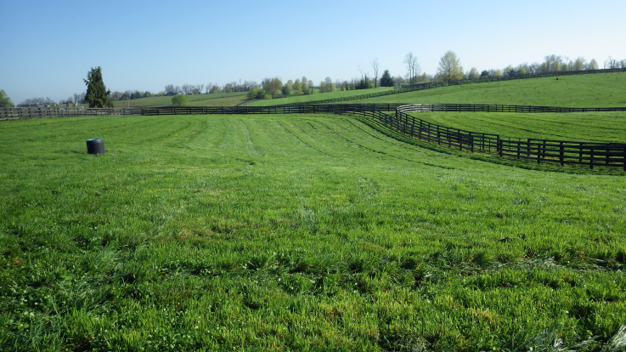
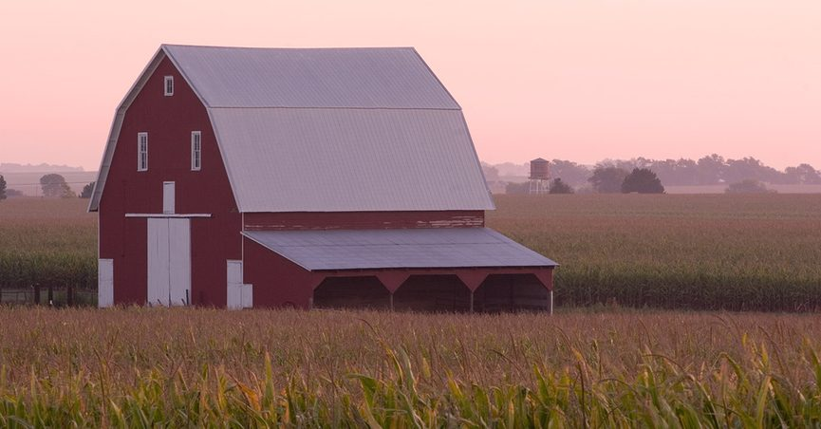
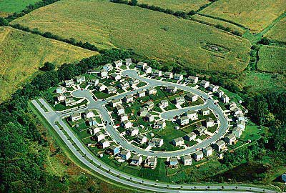
Retention of agricultural lands has long been strongly supported
…. Value in mitigating climate change a new basis for support?
Land-based amenities
  A backbone for our “green infrastructure”
  Valued open space in an urbanized state
  A sense of place and local identity
  Local fiscal benefits
  Cultural and historic value
  Aesthetics
  Ecosystem & environmental benefits
Recognition of carbon benefits and movement to climate-friendly/climate-adaptive practices may represent the next phase of farm policy.

Slide 3
NJ Farm Policy - A Brief Chronology
Decade | Initiative
1950s/1960s | Hughes' Farmland Assessment Committee (Tax relief for farmland owners)
1970s | Blueprint Commission on the Future of NJ Agriculture (Farmland Preservation concept)
1980s | Grassroots: An Agriculture Retention and Development Program for New Jersey (1983 Farmland Preservation Program Established)
1990s | FARMS Commission (agricultural viability)
2000s | Agricultural Smart Growth Plan (Economic Development, Natural Resource Conservation and Agricultural Industry Sustainability)
2020s | (Climate mitigation, adaptation and resiliency?)
Notes:
My view of the chronology of major NJ farm policy

Slide 4
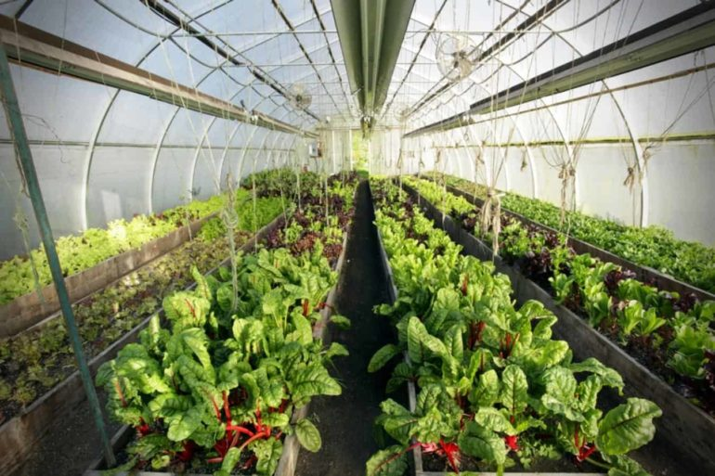
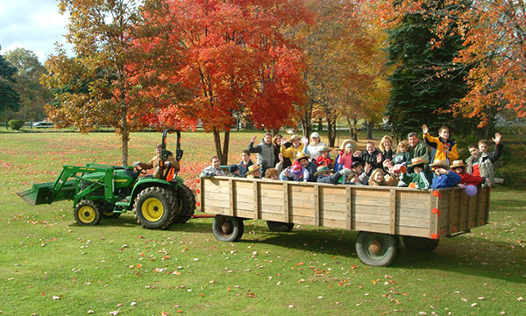
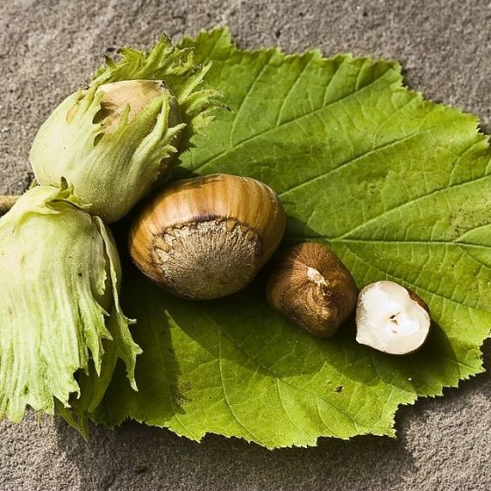
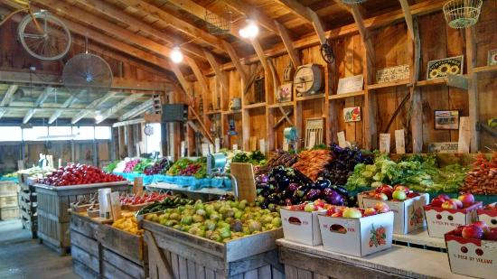
NJAES History of Support for an Ever-Changing Industry
NJAES has deep and diverse expertise to support continued evolution in the industry
  Breeding programs, business/economic analysis, business incubation, agricultural management practices, etc.
Examples of adaptations over recent decades:
  Significant shifts to higher value production
  Expansion of green industry (e.g., nursery, ornamentals)
  Expansion of greenhouse production
  Increased direct marketing
  Alternative enterprise development (i.e. agritourism, niche market development, on-farm energy)

Slide 5
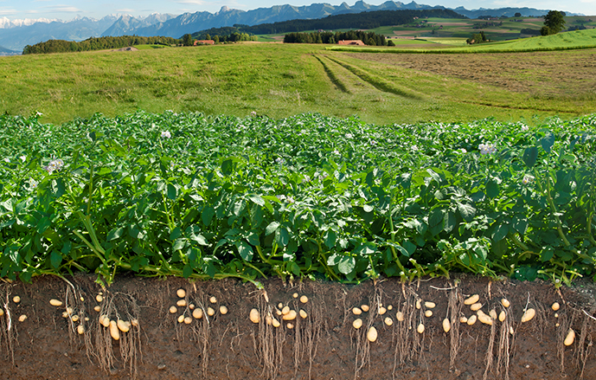
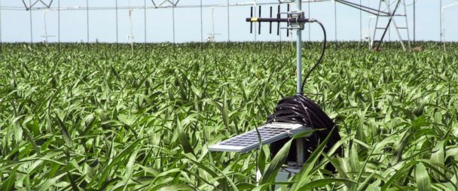

Growing Recognition of Climate Challenges
Regional Cooperative Extension
  Regional conference being planned on agricultural ecosystem services
  Coastal and inland agricultural impacts of climate change
  Climate friendly / climate adaptive farming practices
Climate and farmland preservation
  Significant focus at recent regional roundtable of
  farmland preservation experts and practitioners
Opportunities for LGU partnerships with USDA-NRCS
  Regional Conservation Partnership Program
  NJAES farm demonstrations

Slide 6
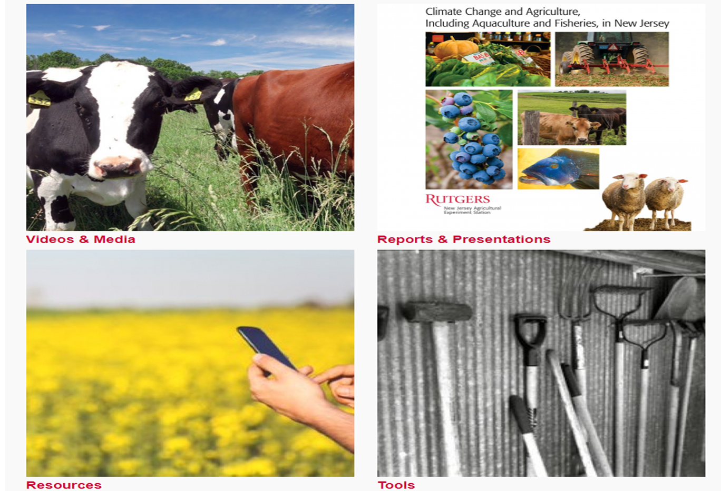

Climate Change & Agriculture
Programs and Resources
Climate Institute
Climate Change & Agriculture Programs and Resources
Northeast Climate Adaptation Fellowship curricula to support integration of climate change information into climate adaptation planning among farmers.
USDA Northeast Climate Hub includes 16 universities in the Northeast working together to make climate information accessible to producers in the Northeast.

Slide 7
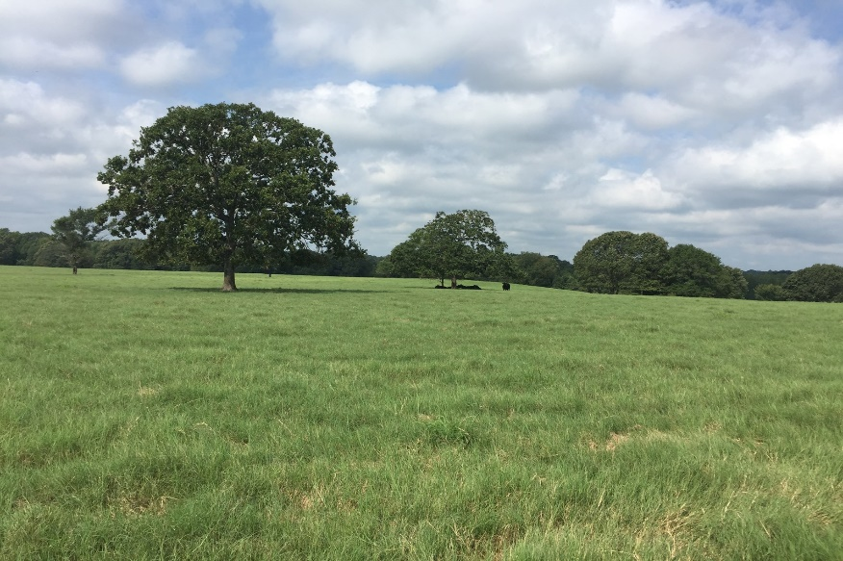
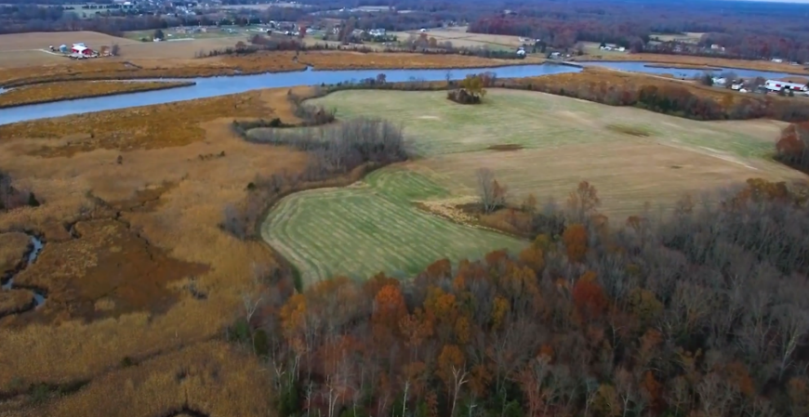
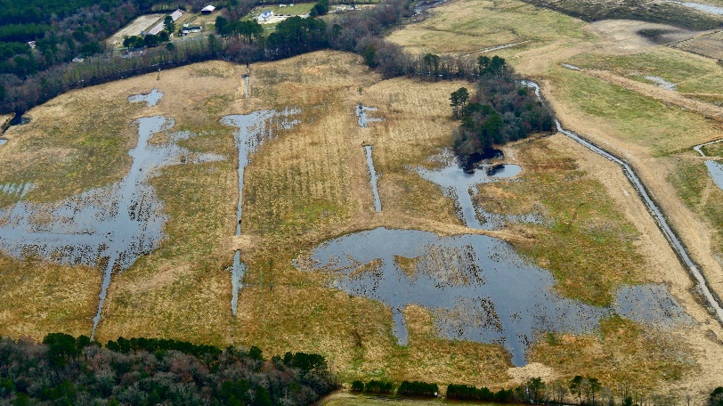
Research & Analyses
Vulnerability of Agriculture to Sea-Level Rise and Coastal Flooding (Climate Institute)
Impacts of Coastal Flooding and Sea-level Rise on Coastal Forests in the Northeast and Mid-Atlantic (Climate Institute - USDA–USFS project)
Climate Stewards: Studying the Feasibility of a Cooperative Extension Climate Change Volunteer Program for the Northeast (RCE - USDA-NIFA project)
Research Spotlight – Dr. Joseph Heckman (NJAES-RCE ):
Changes in soil organic carbon content by converting tilled row crop farmland to pasture.
Annual soil sampling from 2011 to 2019
Results - conversion of tilled land to perennial pasture quickly puts carbon in its place - the topsoil!

Slide 8
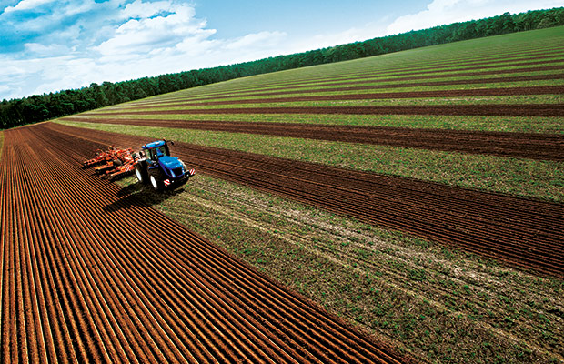

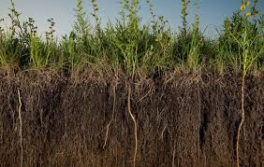
Carbon Credits/Farming
New programs being established that pay farmers who engage in climate
change mitigation practices and reduce carbon emissions.
Indigo Agriculture – www.indigoag.com
  Goal is to sequester a trillion tons of carbon dioxide
  17.8 million acres farmland enrolled
  Farmers can earn $10-15/ton CO₂ sequestered – potential gross income $20-45/acres (2-3 tons/acre)
Carbon Credit programs have opportunities and challenges – i.e. imbalance in the market (Chicago Climate Exchange)
State Initiatives: California Healthy Soils Initiative - competitive grant
  process to encourage carbon farming activities. In 2018, nearly 200 projects
  shared over $8 mil in funding.

Slide 9
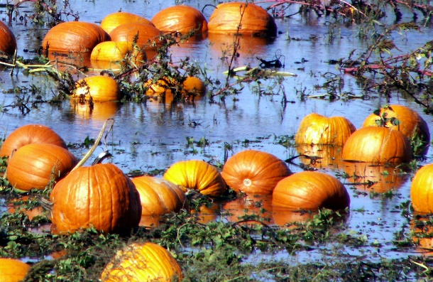
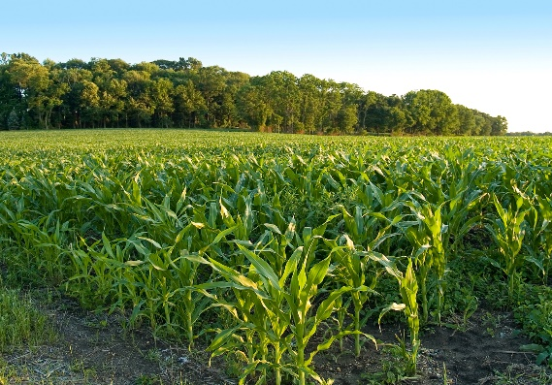
New Programs
November 7, 2019, Duke Farms, the NJFB, NRCS, NJDA and NJAES held a Carbon Farming Workshop to discuss climate-friendly farming practices that benefit the environment while benefiting producers' bottom line.
NJAES creating a Climate Change Resource Center and a Climate-smart Agriculture
Program to provide research and outreach on carbon reduction/sequestration
practices and climate change adaptation farming practices, i.e.
  Listening sessions with farmers statewide
  Examine salinity infiltration on coastal farms
  Review/development of economic models for ecosystem service values
  (primarily carbon sequestration/carbon markets) and others.
Developing plan for NJAES research farms to serve as models for best
practices in soil health, water management and climate change mitigation.
Expanding NJADAPT mapping and visualization tool to include information on
  agriculture. Provides a new approach to understanding the impacts of rising temperatures and future flood events under sea-level rise conditions. www.njadapt.org.

Slide 10
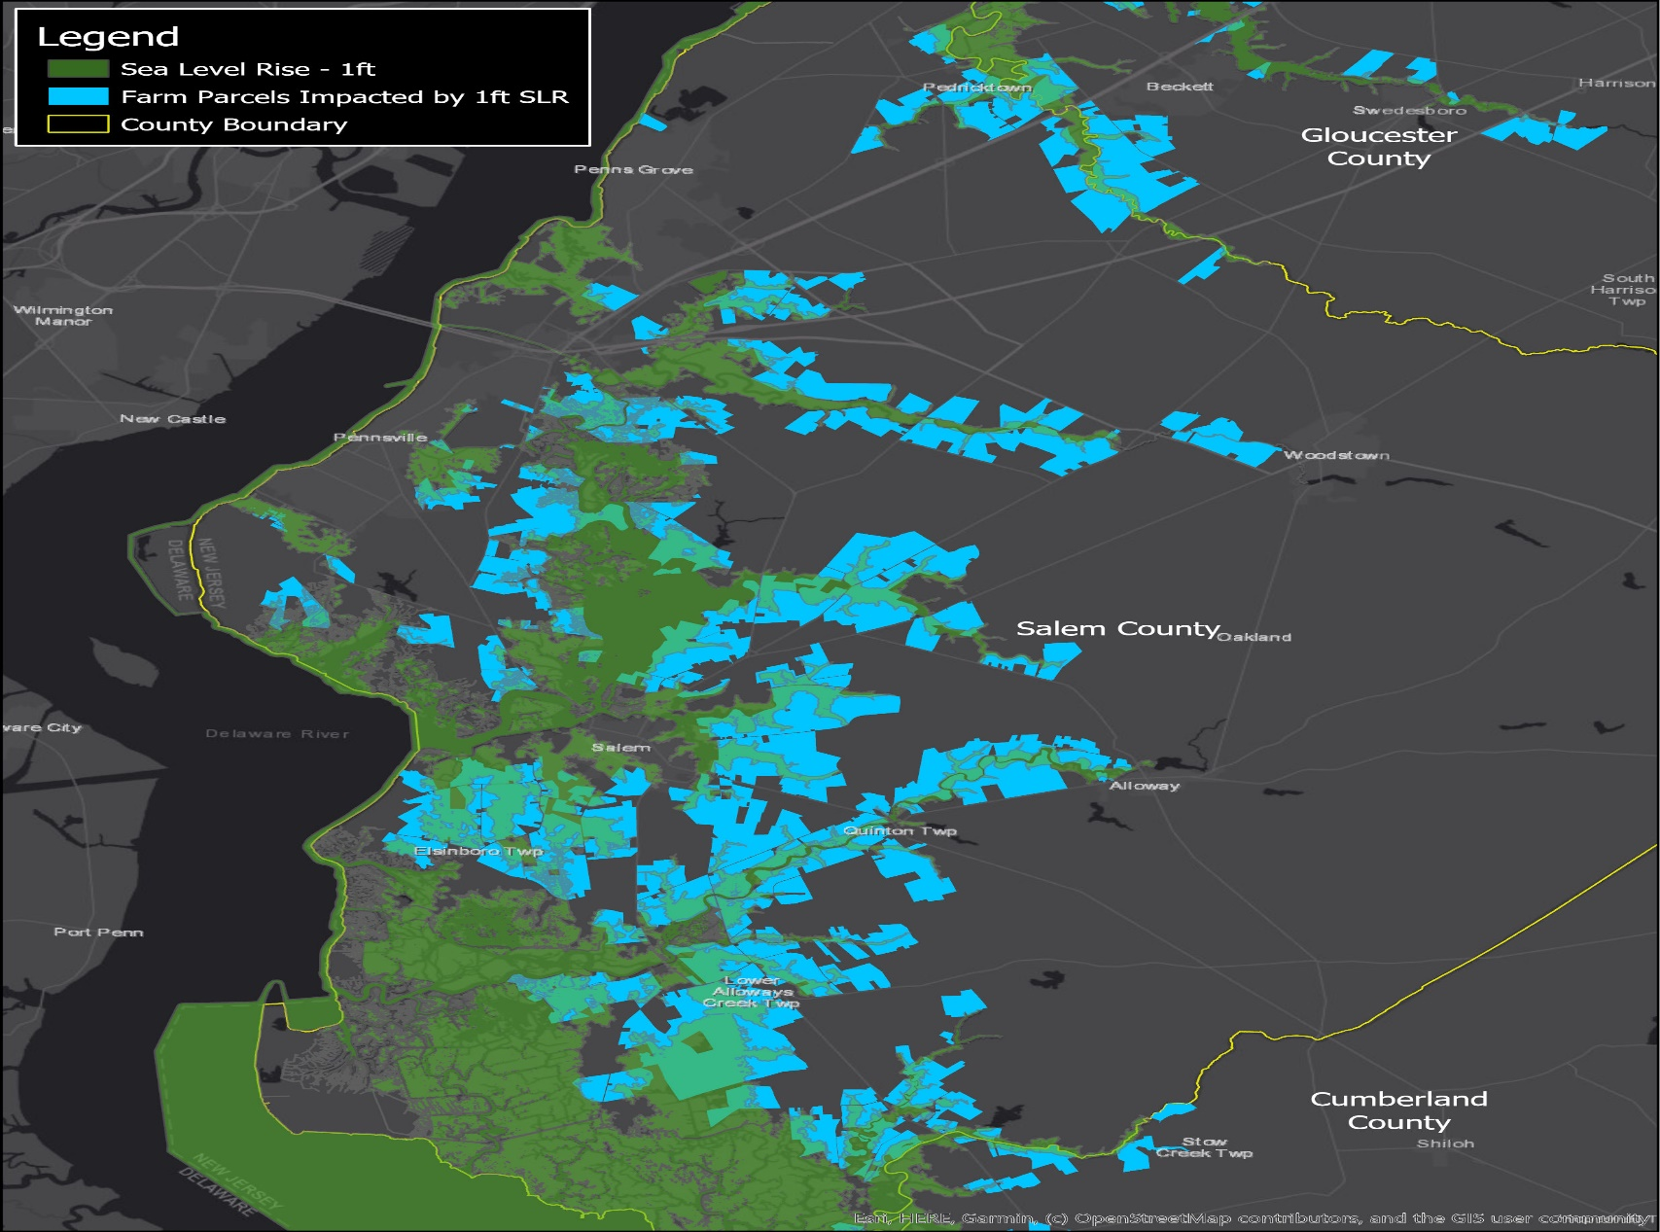
Sea Level Rise: Potential Areas of Impact
NJ SLR Projections (Kopp et al. 2019)
2050: 1.4 feet (likely range: 0.9 to 2.1 ft)
2070: low emissions: 1.79 feet
(likely range: 1.3 to 2.7 feet)
2070: high emissions: 2.4 feet
(likely range: 1.5 to 3.5 feet)
1 ft: 16,725 acres
3 ft: 23,364 acres
1 ft: 45,197 acres ($17.8 million)
3 ft: 52, 386 acres ($21 million)
*Does not include non-qualified farmland on properties; if so, assessed value doubles (2017 property tax parcel data)
Agricultural Land Acres Inundated*
Agricultural Parcels Acres at Risk *
Farm parcels impacted by 1’ of Sea Level Rise by 2050

Slide 11
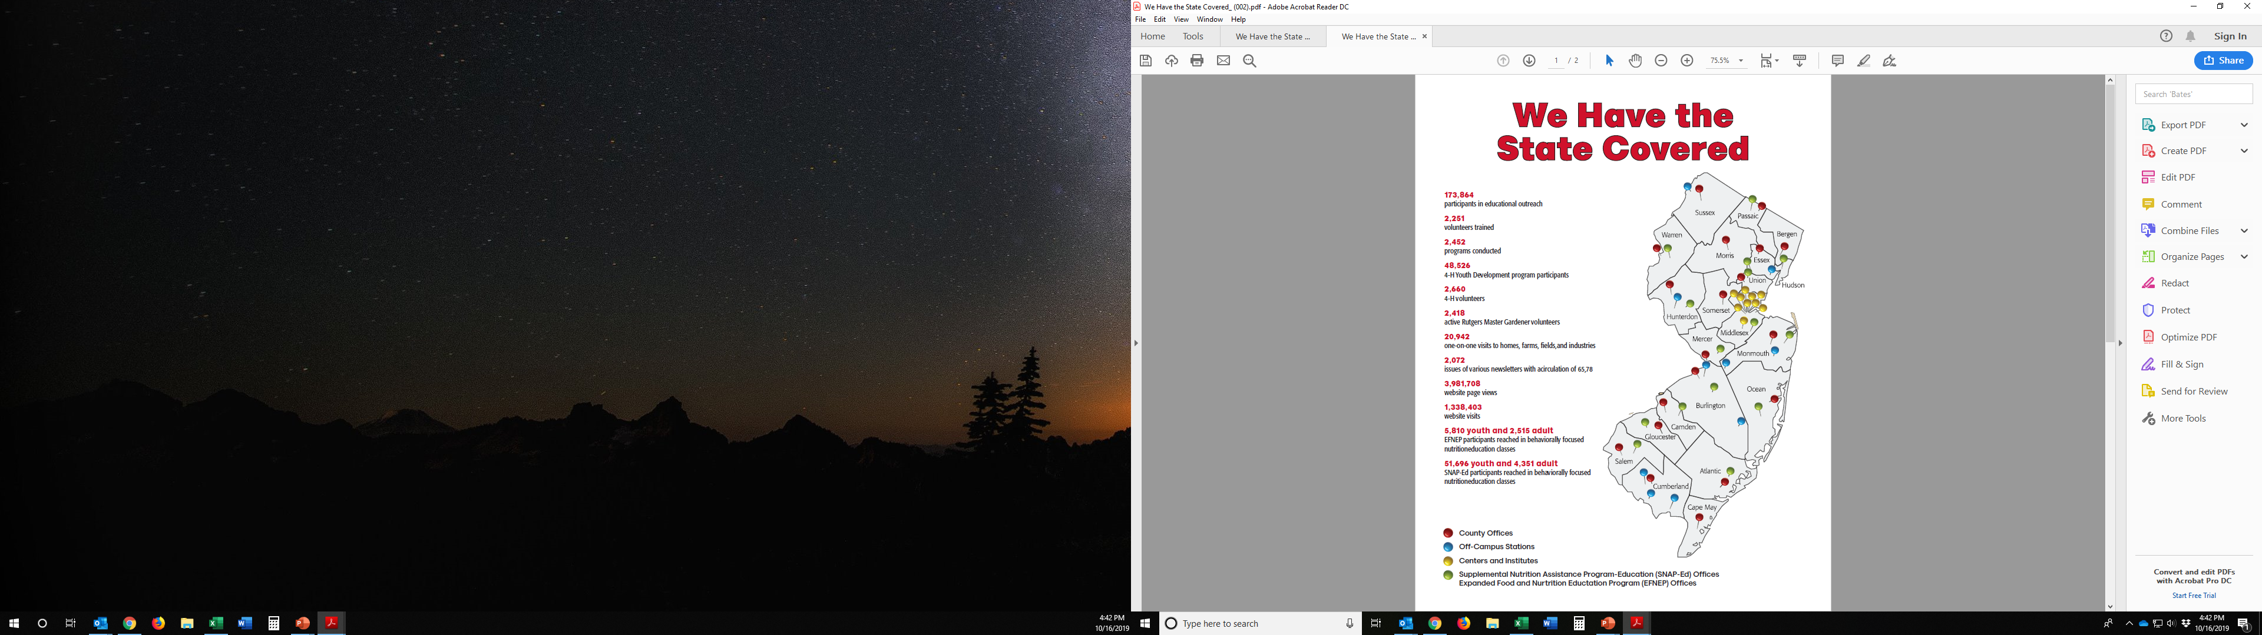
NJAES stands ready to support industry efforts to adapt to climate pressures and adopt sound conservation practices.
Substantial statewide infrastructure
20 County offices are gateways to resources and expertise of RU/national Cooperative Extension
30+ “outlying stations” and research facilities/programs
  Research farms
  Applied research
  Business incubation
  Demonstration sites
Campus-based research

Slide 12
For More Information:
Peggy Brennan-Tonetta
mbrennan@rutgers.edu
Brian Schilling
brischi@sebs.rutgers.edu
Marjorie Kaplan
mbk65@envsci.rutgers.edu

